Slide 1
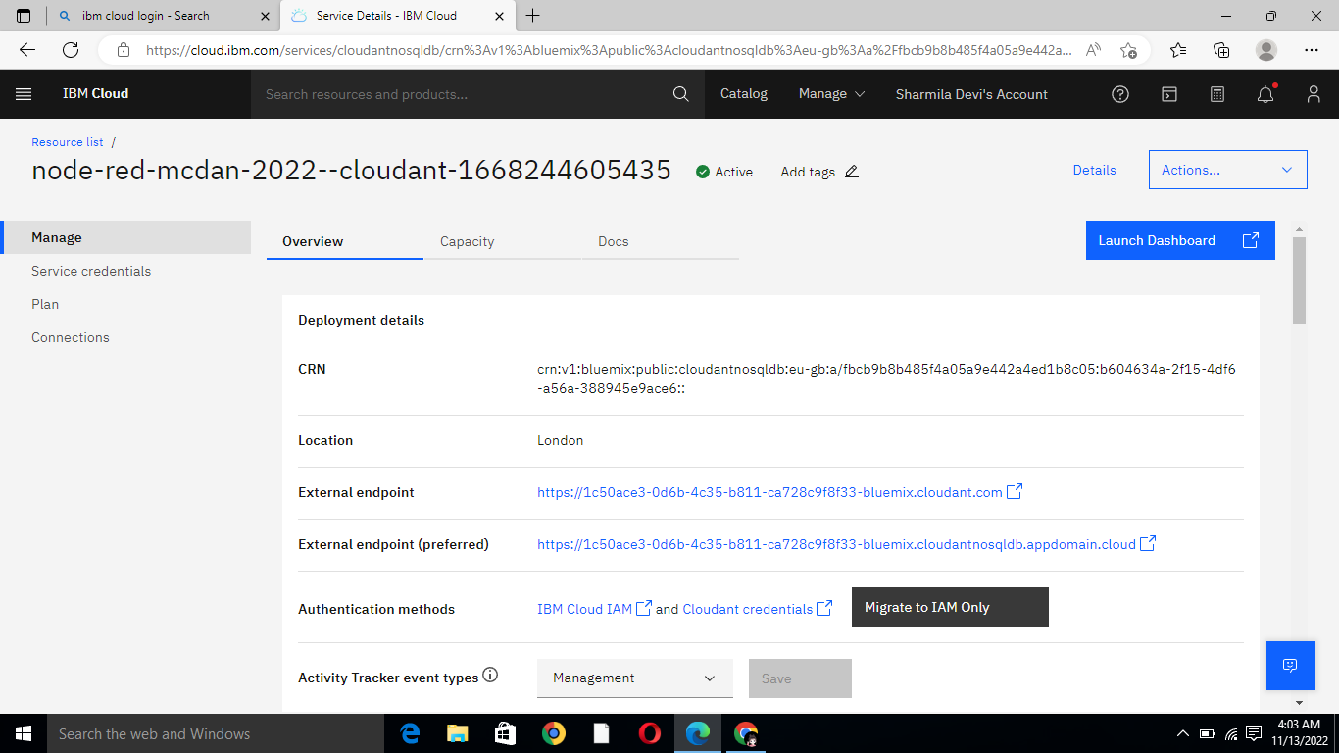
DATE | 13 NOV 2022
TEAM ID | PNT2022TMID48693
PROJECT NAME | Smart waste management system for metropolitan cities
Step 1: Just click on launch dashboard

Slide 2
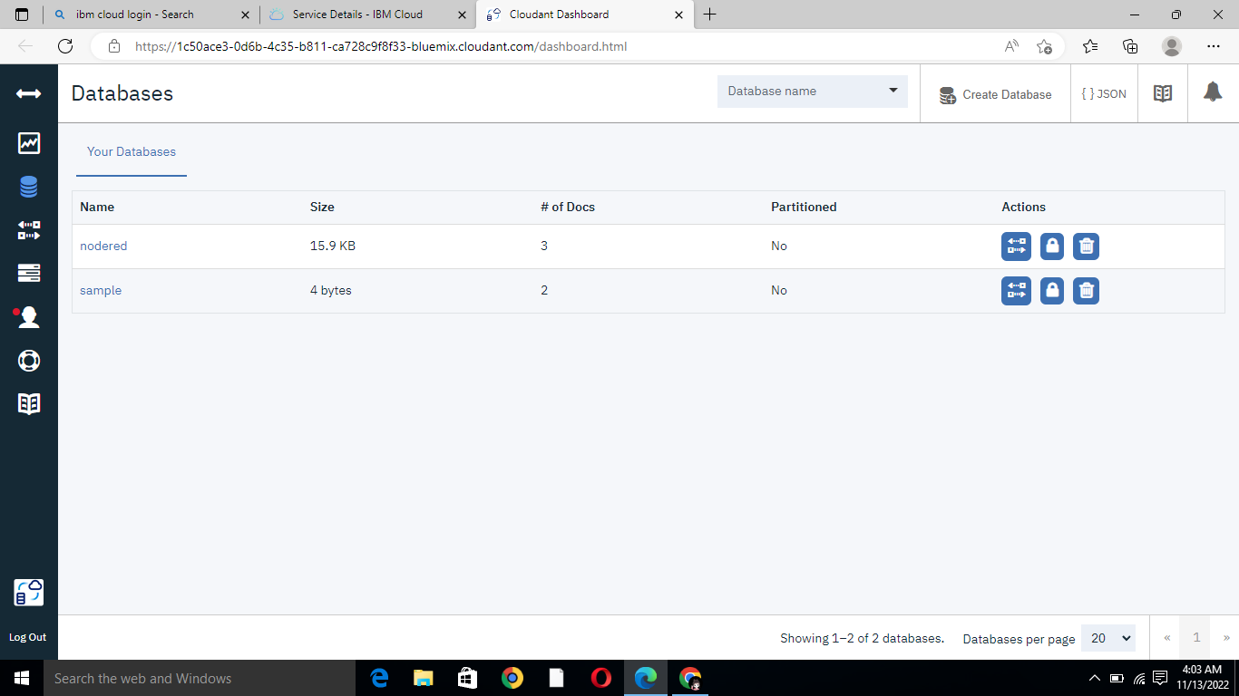
Step 2:Then click on create database

Slide 3
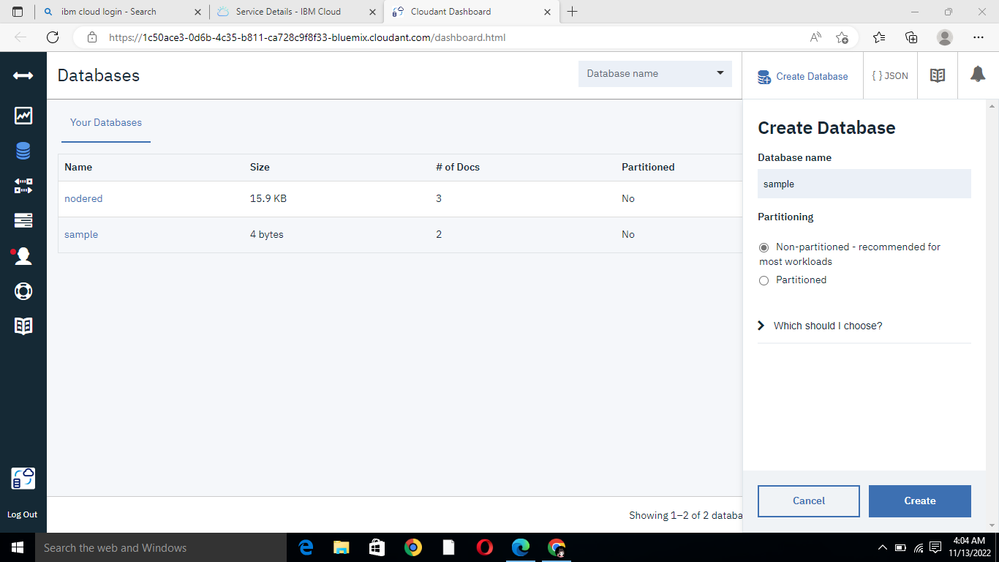
Step 3:Then click on click button

Slide 4
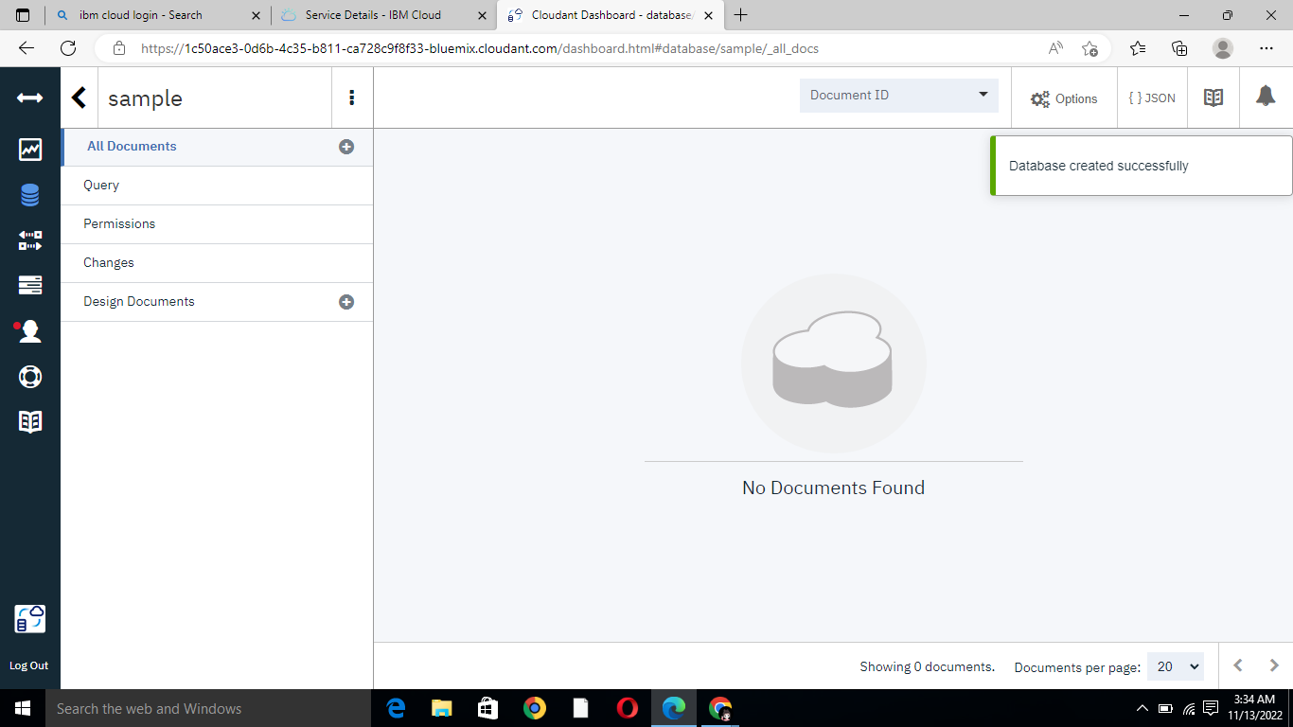
Step 4:

Slide 5
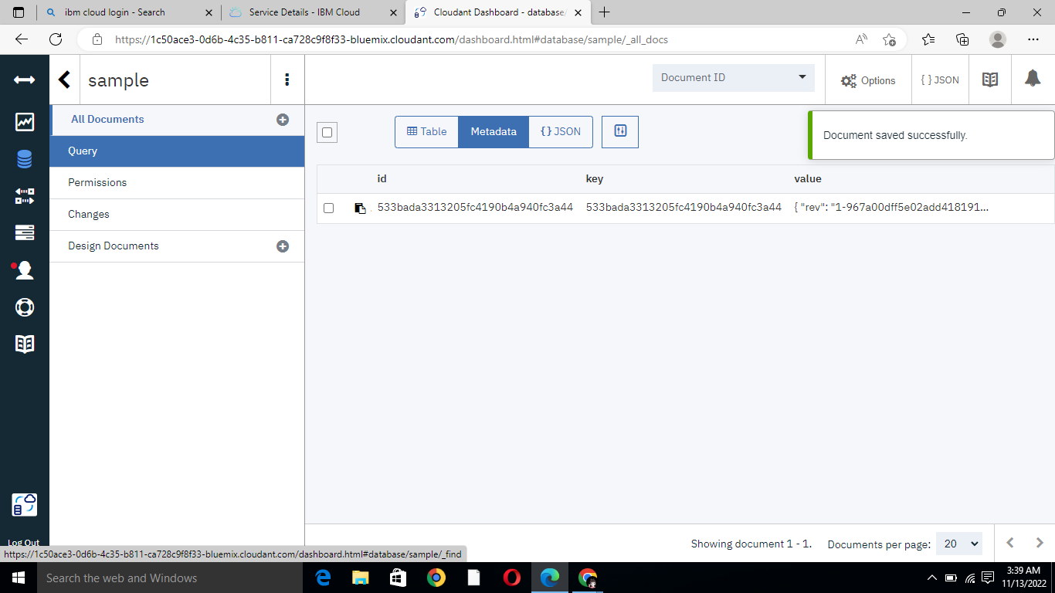
Step 5:

Slide 6
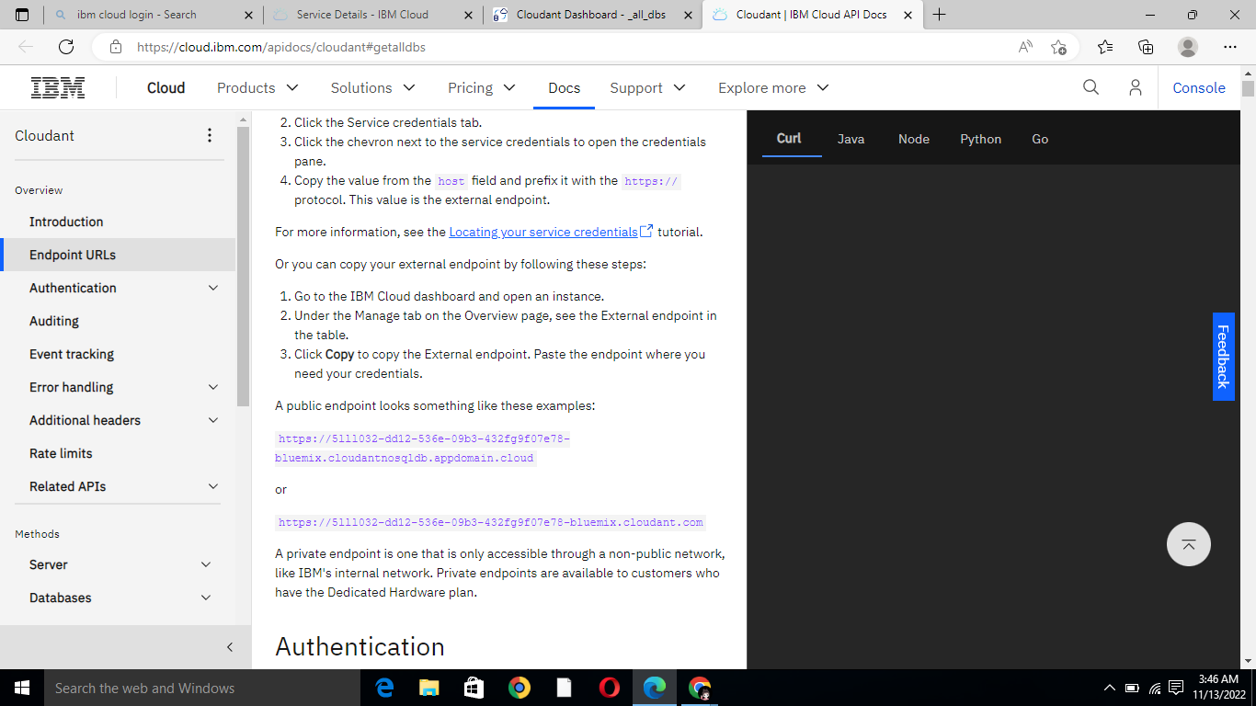
Step 6:

Slide 7
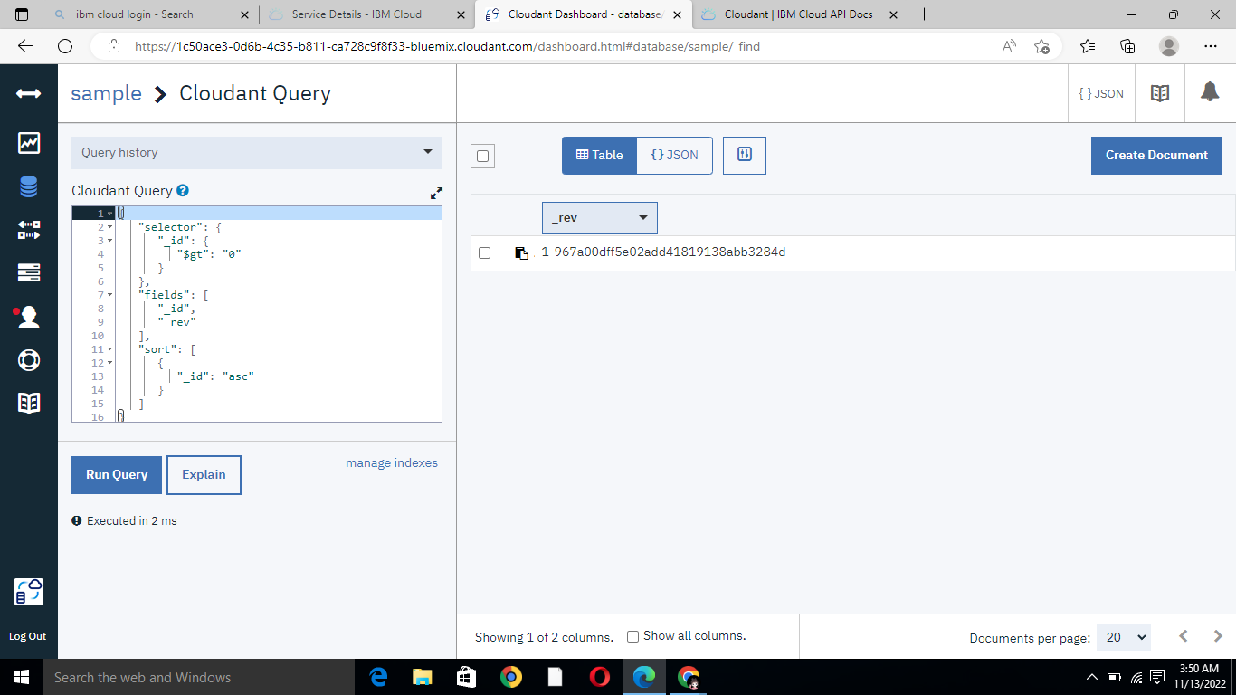
Step 7: Successfully created

